Slide 1
Transcripts by the numbers
Jill A. Pierson
Tools Concept and Data Analysis
February 19, 2016

Slide 2
Office of the registrar-Transcripts
Supports over 40,000 students (present and former students)
Transcript processing is the most requested service
Transcripts are costly to produce
Secure Paper
Secure Envelopes
Postage
Electronic Transcripts

Slide 3
Goals and objectives
Goals
Performance Objective
(Sense and Meaning)
Provide Data on the Number of Transcripts Processed Monthly
Estimate Paper Consumption
Evaluate Postage Costs
Justify the number of employees in the office
Critique and streamline transcript process
Paper Production
Technical Upgrades

Slide 4
Timeline
One month to compile the number of transcripts
Entering the data on the Spreadsheet
Approximately 60 minutes
Data Collection is an ongoing process

Slide 5
Activity
Enter the Number of Transcripts Processed Monthly
E-Transcripts
Paper Transcripts
Resent Transcripts
Compare number of transcripts processed to Previous Fiscal Year
IE-January 2015 to January 2016
Report on the Number Transcripts Processed per Fiscal Year
Average
Minimum
Maximum
Graphical representation of Transcript Data

Slide 6
Basic Skills
Adjust margins, headers, footers, print titles, hyperlink, Fill series, conditional formatting, Built in formulas, cell reference, and absolute formulas

Slide 7
Headers, Footers and Print Titles
Header and Footers
Transcript Report for the month of Jan 2016 is a Print title
Custom Margins
Top Margin .75
Bottom Margin .5
Left Margin and right margin .25
Header and footer .3
Spreadsheet is centered Horizontally and vertically
Legal paper size

Slide 8
Hyperlink, Fill Series, Conditional formatting
Official Transcript is Hyperlinked to the Office of Registrar Webpage
fill Series
Months
Conditional formatting
change text color red for number greater than 5

Slide 9
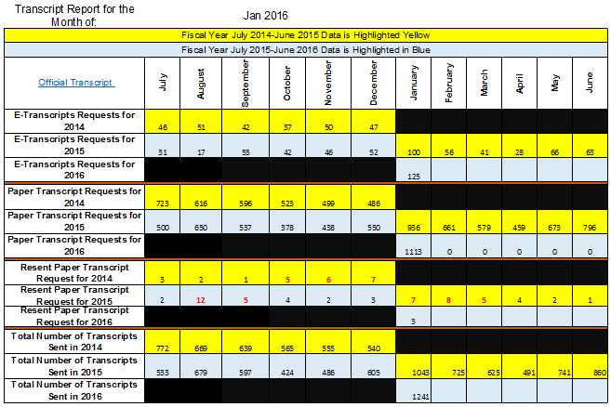
Built in formula and cell reference
Formulas
Sum, Min, Max, Average
Across Different Sheets
Cell Reference
Across different sheets

Slide 10
Absolute Formulas
Absolute Cell Reference
Used in Minimum
Used in Maximum

Slide 11
Advanced features
Graphs and Charts

Slide 12
Bar Graph
Fiscal Years Comparison
Compares number of all transcripts processed in 2014-2015 to 2015-2016
Years are color coded
Data callout
Chart title
X and y axis are labeled

Slide 13
E-Transcripts
Total of E-Transcripts
Graph measures the number of E-transcripts mailed
2014-2015 and 2015-2016 fiscal years
Data callout
X and Y Axis are labeled

Slide 14
Evaluation
CHECK LIST
 | Update the month to reflect current data
 | Add tallies for E-Transcripts, Paper Transcripts, Resent
 | Review monthly sum totals
 | Check summary tab for updates to report
 | Update cell M13 on Summary Data Tab to include current month
 | Check to make sure graph tabs update tallies
 | Update year to date formula to include the current processing
 | Save document to include the fiscal year and current month on the shared drive
 | Email completed workbook to the Registrars

Slide 15
Brainy Bits
Frontal Lobe
Higher order thinking skills (projecting the estimated gains/losses)
Occipital lobe
seeing the data to enhance understanding
visualizing the charts
Parietal Lobe
Calculating totals
Minimum
maximum
Averages
Percentages
(Sousa 16)

Slide 16
bibliography
Slide 2: Clip art Images courtesy of Microsoft clip art files
Slide 4: Clip art Images courtesy of Microsoft clip art files
Slide 15 image: http://bodysystemsprojecct.blogspot.com/2014/03/taking-out-central-nervous-systems.html
Sousa, David. How the Brain Learners. 4th ed. Thousand Oaks, CA: Corwin, 2016. Print

